Slide 1
Missed anomalies- how not to miss?
DR VIDYALEKSHMY R
DGO, DNB,MRCOG

Slide 2
CONGENITAL ANOMALIES
  Real trauma to the family
  Diagnosed usually after 20 Weeks.
  20 Weeks is the upper limit for legal MTP in India.

Slide 3
TAS
Done between 18-23 Weeks
Should be offered to all pregnant women
High sensitivity to detect fetal anomalies
To be done systematically

Slide 4
TAS
SKULL
BRAIN
FACE
CARDIAC
THORAX
ABDOMEN
SKELETAL
PLACENTA AND CERVIX

Slide 5
FACE AND CNS
Transverse view at Septum Cavum Pellucidum- to measure BPD, Head Circumference and Ventricles
Suboccipito bregmatic view- Cerebellum and Cisterna magna

Slide 6
FACE &CNS
Transverse view of face through orbit, upper lip and maxilla
Sagittal view of face to show nasal bone.

Slide 7
NEUROSONOGRAM
Transventricular plane
Transcerebellar plane

Slide 8
Transventricular plane
To measure BPD
Head circumference
Cerebral hemispheres
Ventricles
Choroid plexus

Slide 9
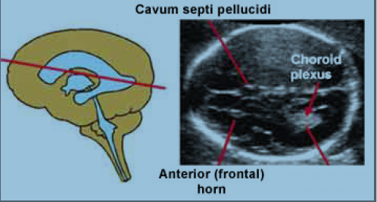
Transventricular plane

Slide 10
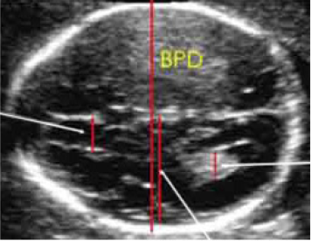
Transventricular plane

Slide 11
Transcerebellar view
Posterior fossa
Cisterna magna
Cerebellum

Slide 12
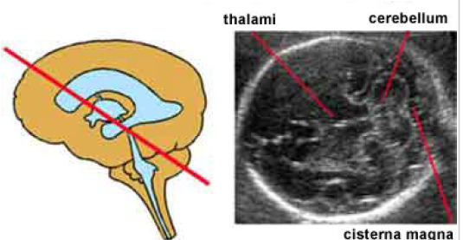
Transcerebellar view

Slide 13
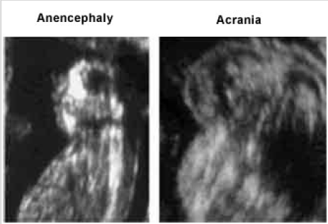
COMMON CNS ANOMALIES

Slide 14
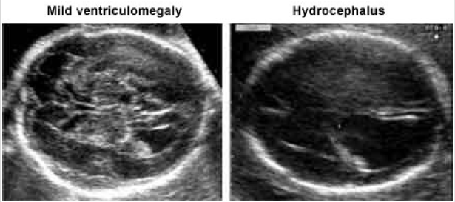
CNS Anomalies

Slide 15
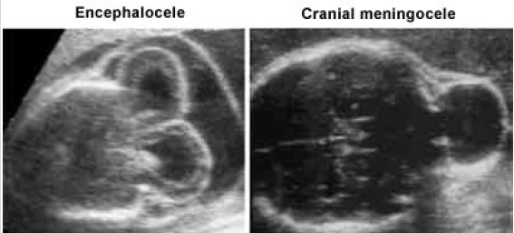
Neural tube defects

Slide 16
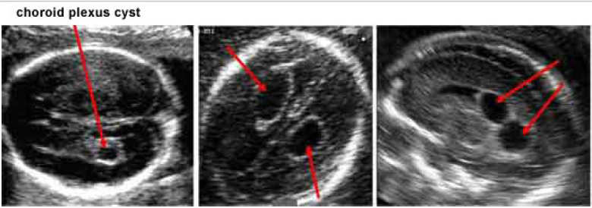
Choroid plexus cyst

Slide 17
FACE
Forehead
Orbit
Nose
Lips
Oral cavity

Slide 18
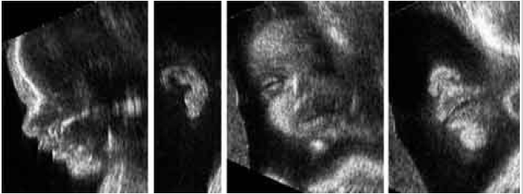
FACE

Slide 19
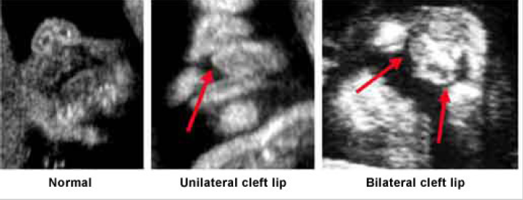
CLEFT LIP & PALATE

Slide 20
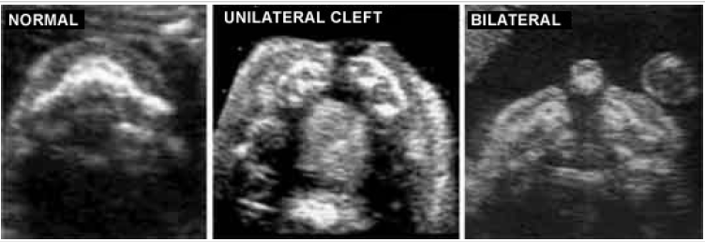
CLEFT PALATE

Slide 21
CARDIAC EVALUATION
Four chamber view
3 vessel view
Ventricular outflow tracts
Heart rate and Rhythm

Slide 22
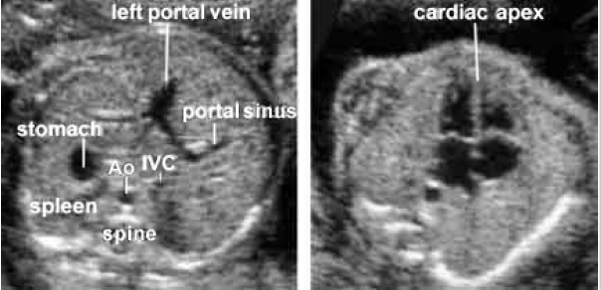
FETAL ECHOCARDIOGRAPHY

Slide 23
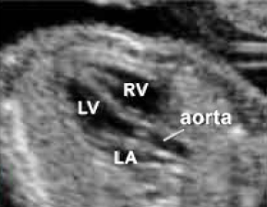
OUTFLOW TRACTS- LV

Slide 24
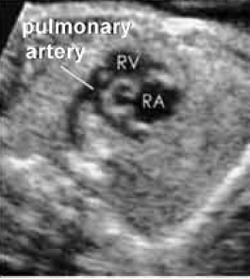
PULMONARY OUTFLOW

Slide 25
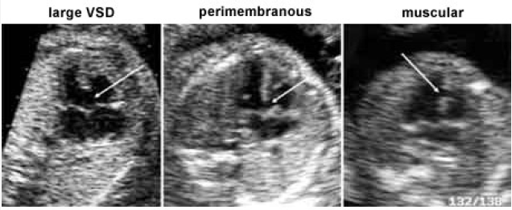
Ventricular Septal defects

Slide 26
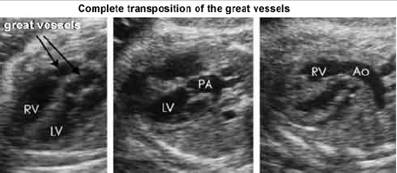
CARDIAC ANOMALIES

Slide 27
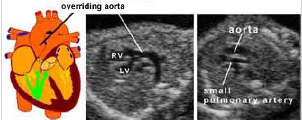
Falot’s Tetrology

Slide 28
THORAX
Shape
Lungs
Diaphragm

Slide 29
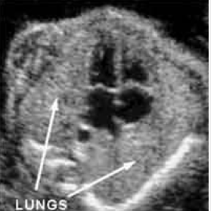
LUNGS

Slide 30
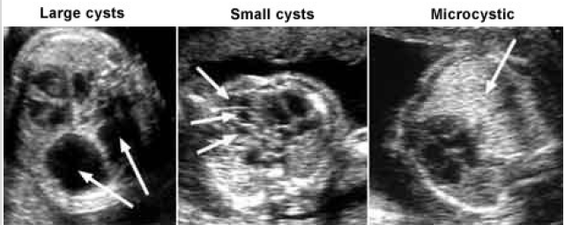
LUNG CYSTS

Slide 31
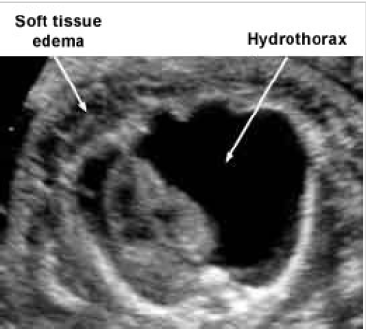
Pleural effusion

Slide 32
ABDOMEN
Abdominal circumference
Transverse view to demonstrate kidneys
Transverse view at umbilicus- Abdominal wall defects
Transverse view at the level of bladder
Stomach, Liver

Slide 33
DIAPHRAGMATIC HERNIA
Diagnosed by the presence of stomach, intestine or liver in thorax
Mediastinal shift

Slide 34
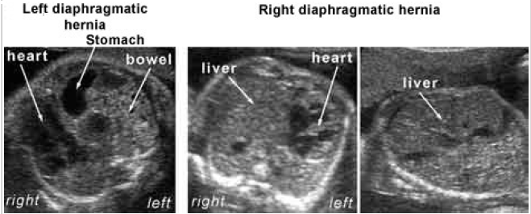
Diaphragmatic Hernia

Slide 35
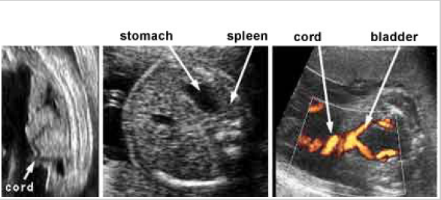
ANTERIOR ABDOMINAL WALL- normal appearance

Slide 36
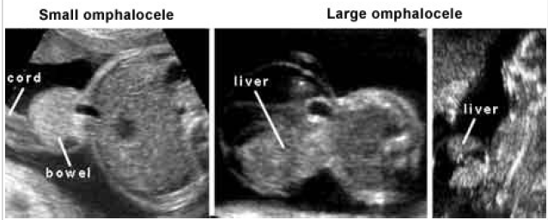
EXOMPHALOS

Slide 37
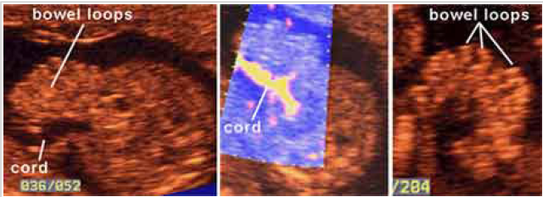
GASTROSCHISIS

Slide 38
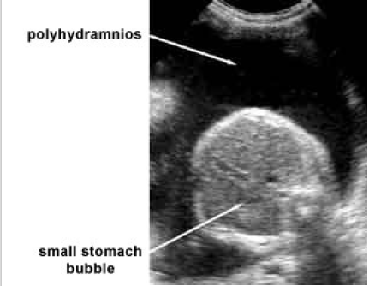
GIT- esophageal atresia

Slide 39
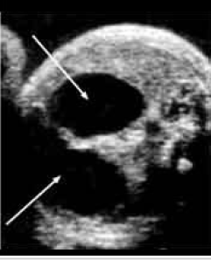
Duodenal atresia- double bubble

Slide 40
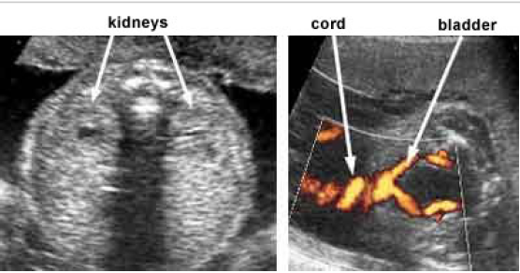
KIDNEYS AND URINARY TRACT

Slide 41
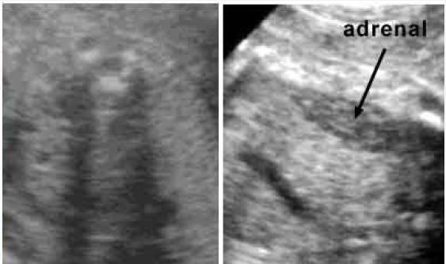
Renal agenesis

Slide 42
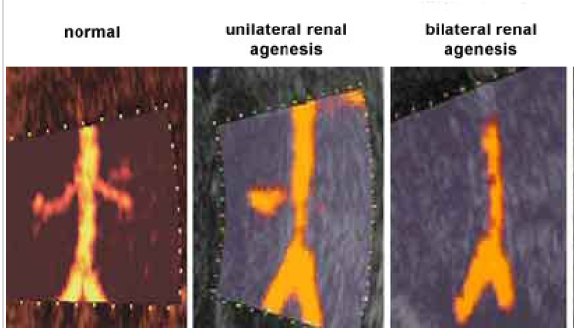
Renal agenesis- renal artery Doppler

Slide 43
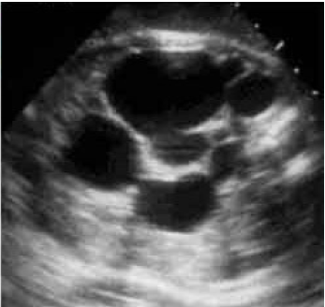
POLYCYSTIC KIDNEY

Slide 44
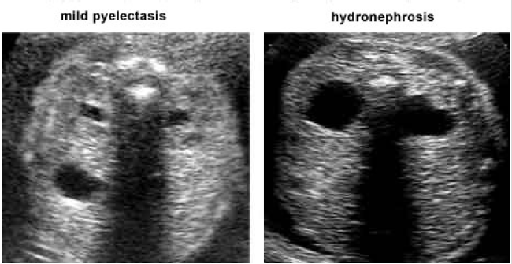
Hydronephrosis

Slide 45
SPINE
Examination of neck for nuchal fold thickness
Longitudinal views of spine- at least 2 views
Coronal view at Lumbosacral region
Transverse view

Slide 46
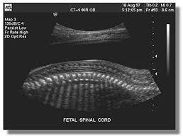
SPINE

Slide 47
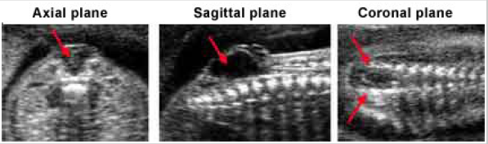
Spinal Anomalies

Slide 48
SKELETAL EVALUATION
Longitudinal view of femur
Longitudinal view of foot and leg
Upper limb bones
Imaging of open hand
Fetal movements

Slide 49
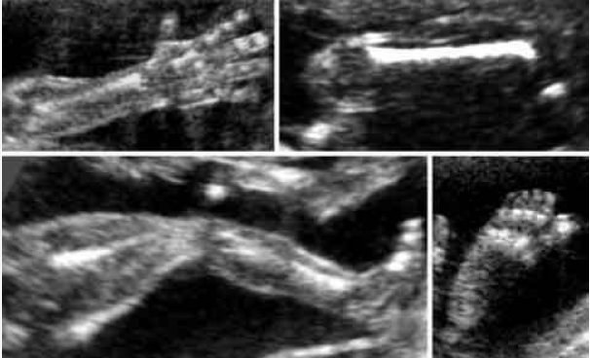
SKELETON

Slide 50
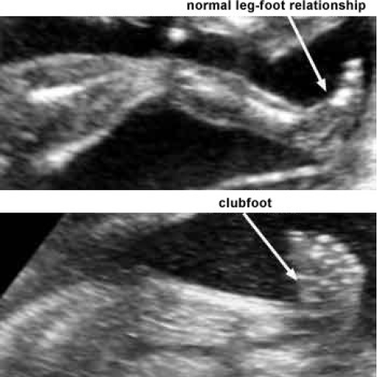
CLUBFOOT- CTEV

Slide 51
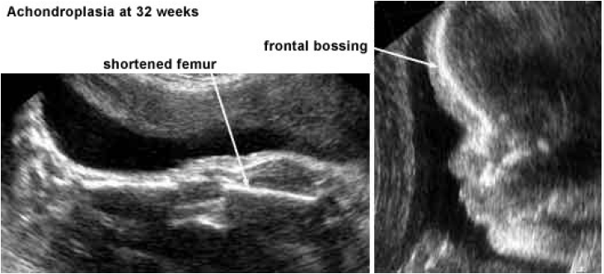
Achondroplasia

Slide 52
OTHER ANOMALIES
Chromosomal anomalies- major and minor markers
Fetal tumours
Hydrops fetalis

Slide 53
WHY ANOMALIES ARE MISSED ??
TOO EARLY TO DIAGNOSE.
EVOLVING ANOMALY
OPERATOR INEXPERIENCE
NOT FOLLOWING PROTOCOLS

Slide 54
THANK YOU

